Slide 1


Enterprise Credit Card Fraud Intelligence & Risk Analytics
45-Day Industrial Training Report · Microsoft Power BI
HARSIMRAT KAUR · 23303120
WHITE HAT CODERS, MOHALI
JUNE 2026
Department of Computer Science and Engineering · Sardar Beant Singh State University, Gurdaspur
Notes:
1

Slide 2


The Growing Threat of Financial Fraud
The rapid expansion of digital payments has transformed banking — but it has also opened new avenues for cybercrime. Financial institutions process millions of transactions daily, yet traditional rule-based detection systems cannot keep pace with evolving fraud patterns.
Scale of the Problem
Limitations of Legacy Systems
Millions of daily transactions make manual monitoring impractical and costly.
Static rules fail to detect complex fraud patterns hidden in large datasets.
The Business Intelligence Opportunity
Modern BI tools transform raw transaction data into real-time, actionable insights.
Notes:
2

Slide 3


Project Objectives
This project develops an interactive Business Intelligence solution to analyse large-scale financial transaction data, detect fraud, and support data-driven decision-making through Microsoft Power BI.
1
2
3
Analyse 1M+ Transactions
Detect Fraudulent Activity
Build Interactive Dashboards
Process the PaySim dataset efficiently using Power BI.
Identify suspicious patterns and high-risk transactions.
Visualise KPIs, trends, and fraud metrics dynamically.
4
5
Implement Star Schema
Enable Future AI Integration
Design an optimised data model for performance and scalability.
Create a scalable foundation for ML-based fraud prediction.
Notes:
3

Slide 4

Project Methodology
A structured, end-to-end Data Analytics workflow was followed — from raw data acquisition through to final business reporting — ensuring accuracy, scalability, and reliability at every stage.
Data Collection
Data Cleaning
Transformation
DAX Measures
Star Schema
Each stage builds upon the previous, ensuring that raw PaySim transaction data is systematically transformed into meaningful business intelligence ready for executive decision-making.
Notes:
4

Slide 5

Tools & Technologies
Tool
Purpose
Microsoft Power BI Desktop
Dashboard development, data modelling, KPI creation
Power Query Editor
Data cleaning, transformation, and ETL operations
DAX (Data Analysis Expressions)
Dynamic measures, KPIs, and analytical calculations
PaySim Dataset
Primary dataset — 1,048,575 simulated transactions
Microsoft Excel
Initial data inspection and output validation
Microsoft Word & PowerPoint
Report documentation and project presentation
Notes:
5

Slide 6
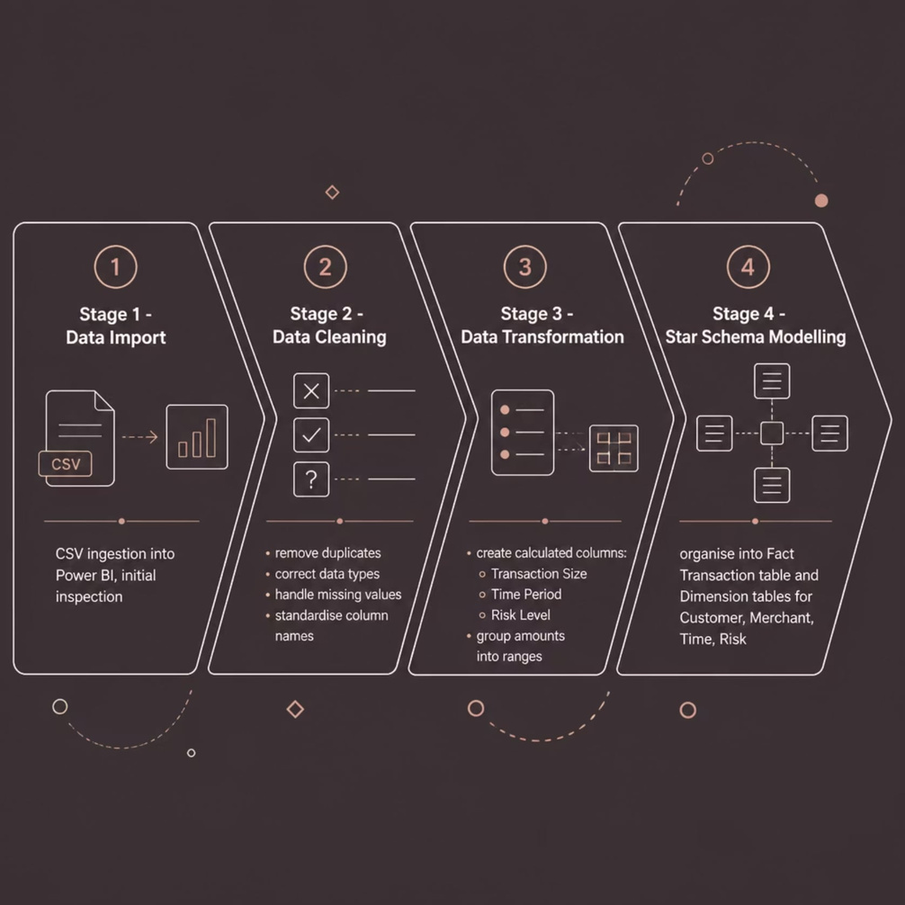
PaySim Dataset & Data Preparation
Dataset Overview
The PaySim Financial Transaction Dataset simulates real-world mobile money transactions, containing 1,048,575 records across 11 attributes — including transaction type, amount, customer and merchant IDs, account balances, and fraud labels.
Transaction types include CASH_IN, CASH_OUT, TRANSFER, PAYMENT, and DEBIT — enabling rich comparative analysis.
Notes:
6

Slide 7
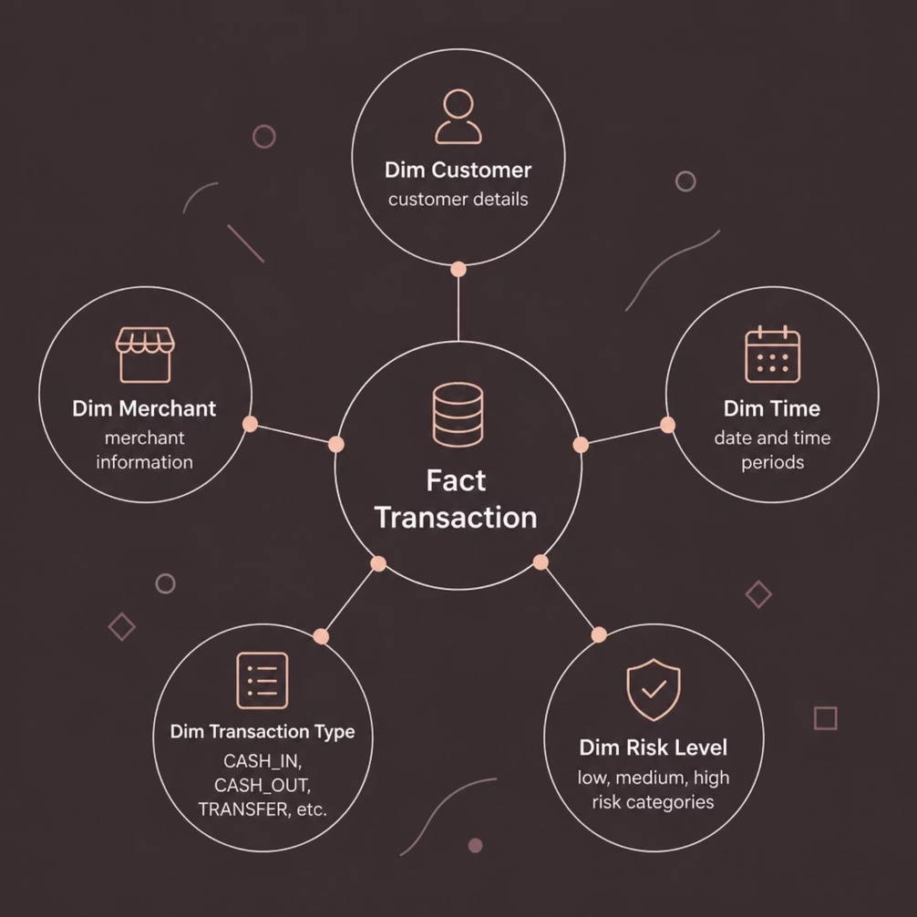
Star Schema Data Model & DAX Measures
Star Schema Architecture
A central Fact Transaction table stores all measurable transaction data, connected to dimension tables for Customer, Merchant, Time, Transaction Type, and Risk Level. This structure minimises redundancy and accelerates query performance.
Fraud Rate (%)
Success Rate (%)
Percentage of fraudulent transactions vs. total volume.
Proportion of genuine, successfully completed transactions.
High-Risk Customers
Fraud Merchant Count
Customers associated with suspicious or fraudulent activity.
Merchants linked to fraudulent transactions.
Notes:
7

Slide 8



Three Interactive Dashboards
Executive Fraud Intelligence Dashboard
Transaction Analytics Dashboard
Fraud Behaviour Dashboard
Focused fraud analysis — high-risk customers, fraud-involved merchants, transaction-type vulnerability, and emerging fraud patterns.
High-level KPIs — Total Transactions, Fraud Rate, Success Rate — with fraud distribution charts and trend analysis for senior management.
Detailed breakdown of transaction volumes by type (CASH_IN, TRANSFER, PAYMENT), average amounts, and time-based trend analysis.
Notes:
8

Slide 9

Key Business Insights
Low Fraud Rate, High Financial Impact
Fraudulent transactions are a small percentage of total volume, yet each carries significant financial consequence — continuous monitoring remains essential.
Fraud Concentrates in Specific Transaction Types
Certain categories are disproportionately targeted, indicating the need for stricter verification on high-risk transaction types.
Merchant-Level Monitoring Strengthens Detection
Only a limited number of merchants are linked to fraud — targeted merchant analytics enables early identification of suspicious entities.
Interactive Dashboards Accelerate Decision-Making
Dynamic KPIs and filters provide real-time business intelligence, eliminating manual report preparation and reducing analysis time.
Notes:
9

Slide 10

Conclusion & Future Scope
Conclusion
Future Enhancements
This project demonstrates that Business Intelligence tools — specifically Microsoft Power BI — can effectively transform over one million financial transaction records into actionable fraud intelligence. Three interactive dashboards deliver real-time insights into transaction performance, fraud trends, and risk patterns, significantly reducing manual reporting effort while improving decision-making accuracy.
Machine Learning Integration — Predictive models (Random Forest, XGBoost) for proactive fraud prevention.
Real-Time Monitoring — Live data streaming via Power BI Service and Azure for instant fraud alerts.
AI-Powered Anomaly Detection — Automated risk scoring for customers and merchants.
Enriched Data Sources — Integration of customer demographics, geolocation, and device data.
Notes:
10

